Slide 1
PDF Downloader
Made by Sigurros Inga Helgadottir

Slide 2
The Project description
In the beginning I received a message with the projects requirements:
You will receive an Excel file (GRI_2017_2020), containing links to PDFs, that we want downloaded
Each row in the data has an id, a link and a backup link
We want the information about the successful and unsuccessful downloads to be entered to a new Excel document
The downloaded PDFs should be sorted by id in the destination folder
It would be a big plus if
The program could “remember” which files have been downloaded, to avoid duplicate files when more links are added to the file
The program had a reset for the downloaded information files, just in case something happens
There should be a guide for the program so everyone can use it
Choose whichever languages and technologies you think would fit best

Slide 3
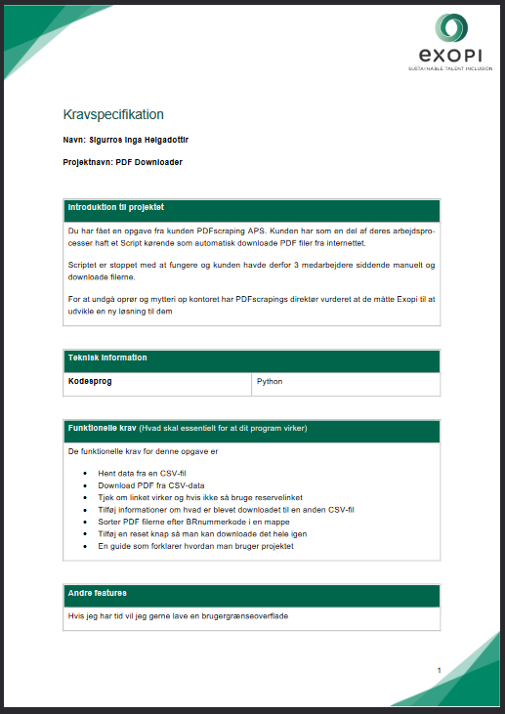
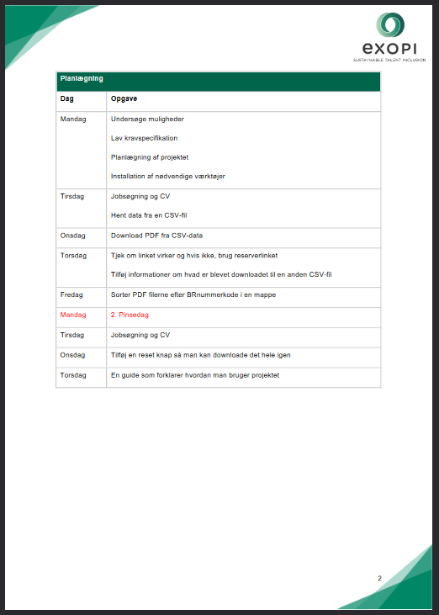

Slide 4
Now let’s take a look at the project

Slide 5
Questions?

